Slide 1
Indoor wifi fingerprint-based localization
Xi
23.01.2019

Slide 2
Why
What
How
Where
Insights
Indoor wifi fingerprint-based localization

Slide 3
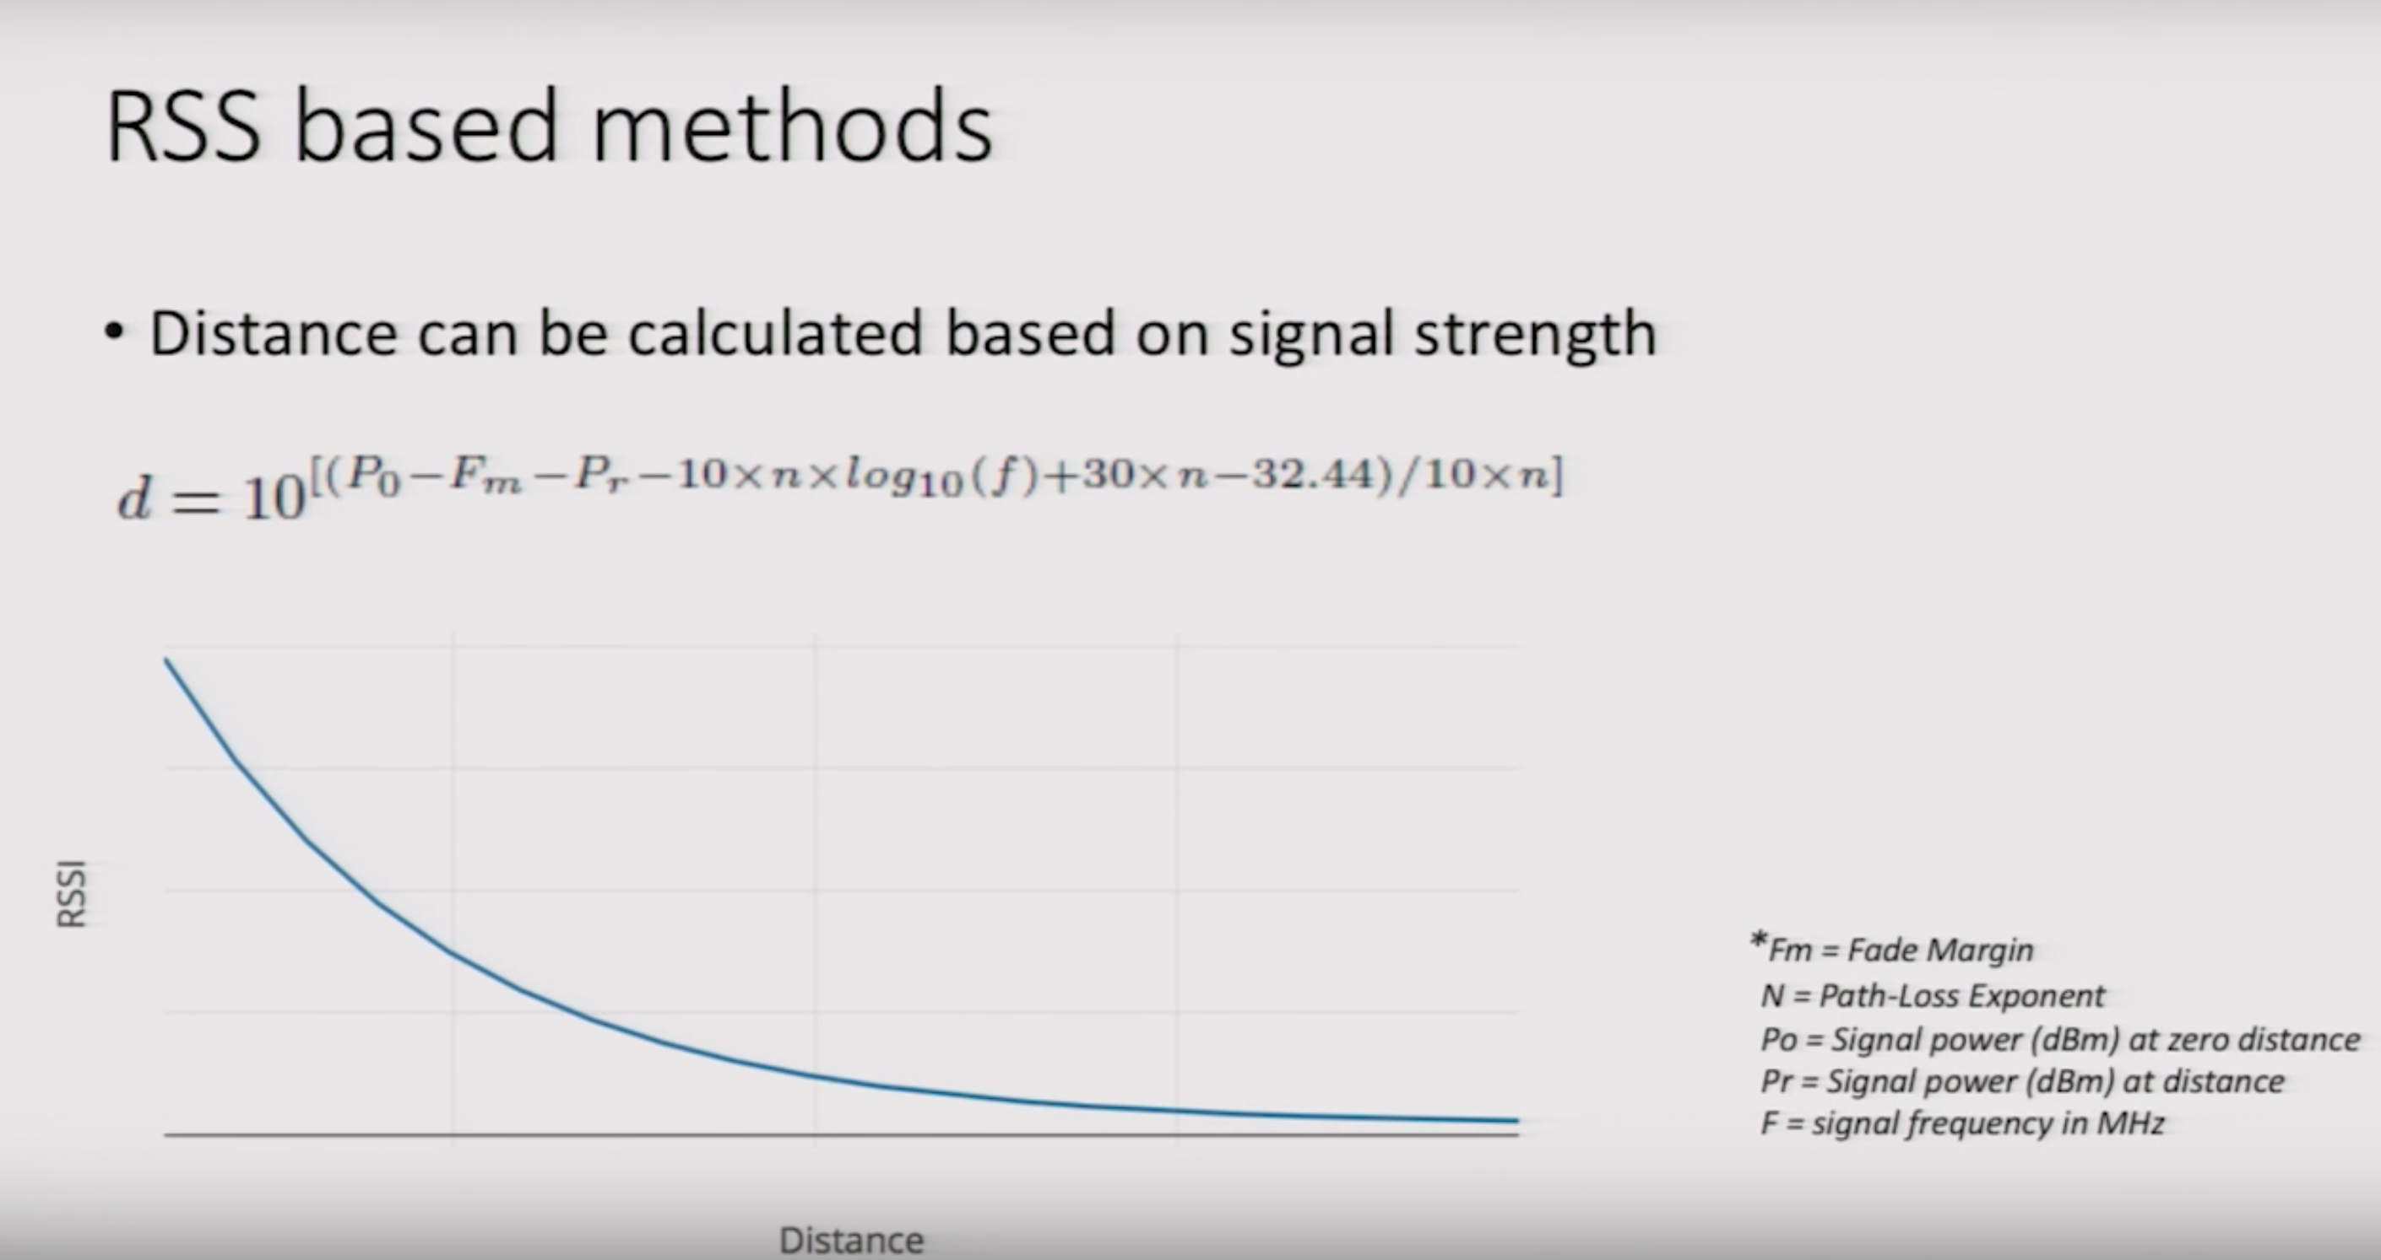
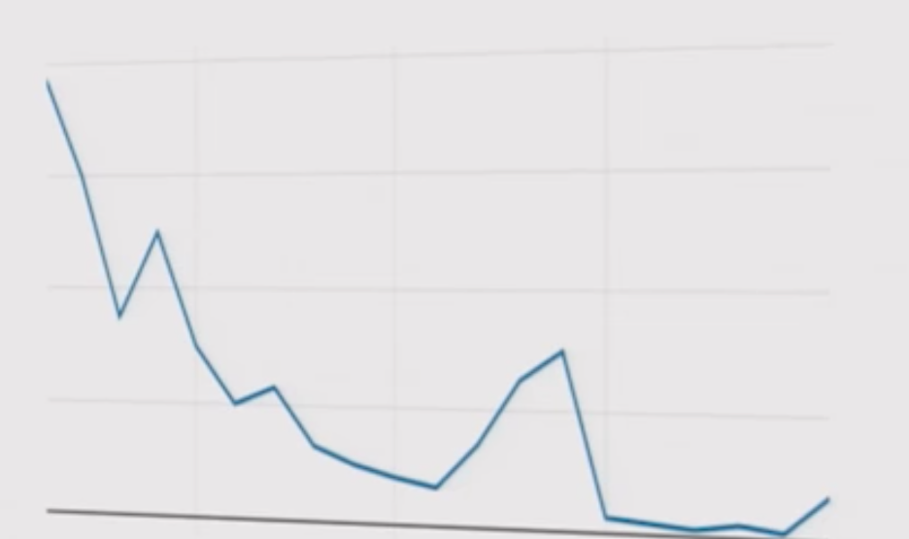
Indoor Localization
Reality
Alternative method?

Slide 4



Wifi fingerprint-based localization
Input: Sample collection
Radio map construction
Output: A mapping function:
From RSSI to Location space
Compared RSSI with the training samples of the radio map.
RSSI comparison
Position
The most similar sample in the radio map.

Slide 5
Data Information
Training Dataset: 19,937 records
Validation Dataset: 1,111 records
001-520 RSSI levels: from -104 to 0 and +100 (no signal detected)
521-523 Real world coordinates of the sample points: Longitude, Latitude, Floor
524 BuildingID
525 SpaceID
526 Relative position with respect to SpaceID
527-529 Information about registers: UserID, PhoneID, Timestamp

Slide 6

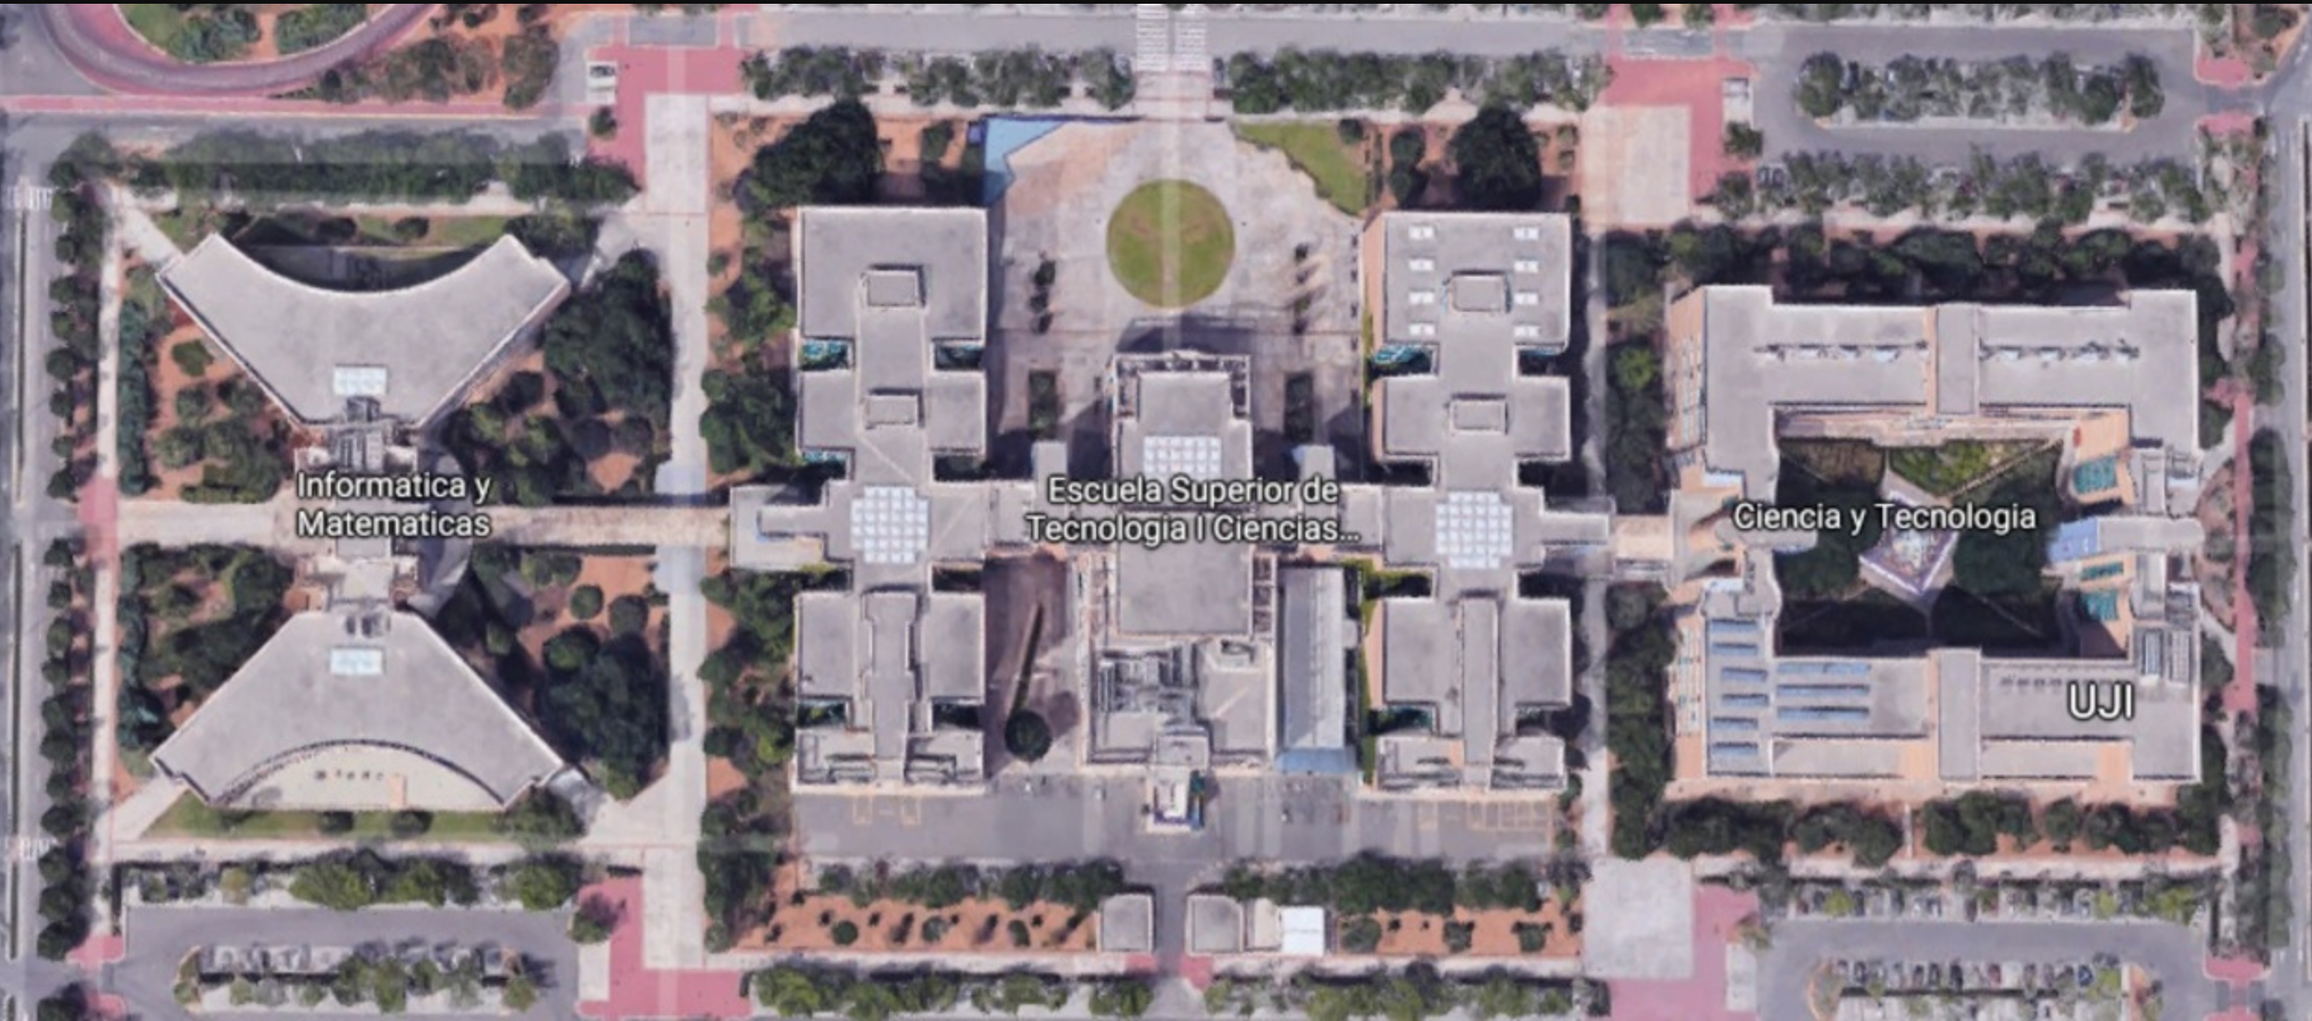


... | WAP3 | WAP4 | WAP9 | WAP11 | ...
... | -72 | -32 | -47 | -64 | ...
Indoor WiFi-based Localization
Location1
(Longitude1,Latitude1)
... | WAP76 | WAP121 | WAP174 | WAP212 | ...
... | -88 | -43 | -49 | -72 | ...
Location2
(Longitude2,Latitude2)

Slide 7
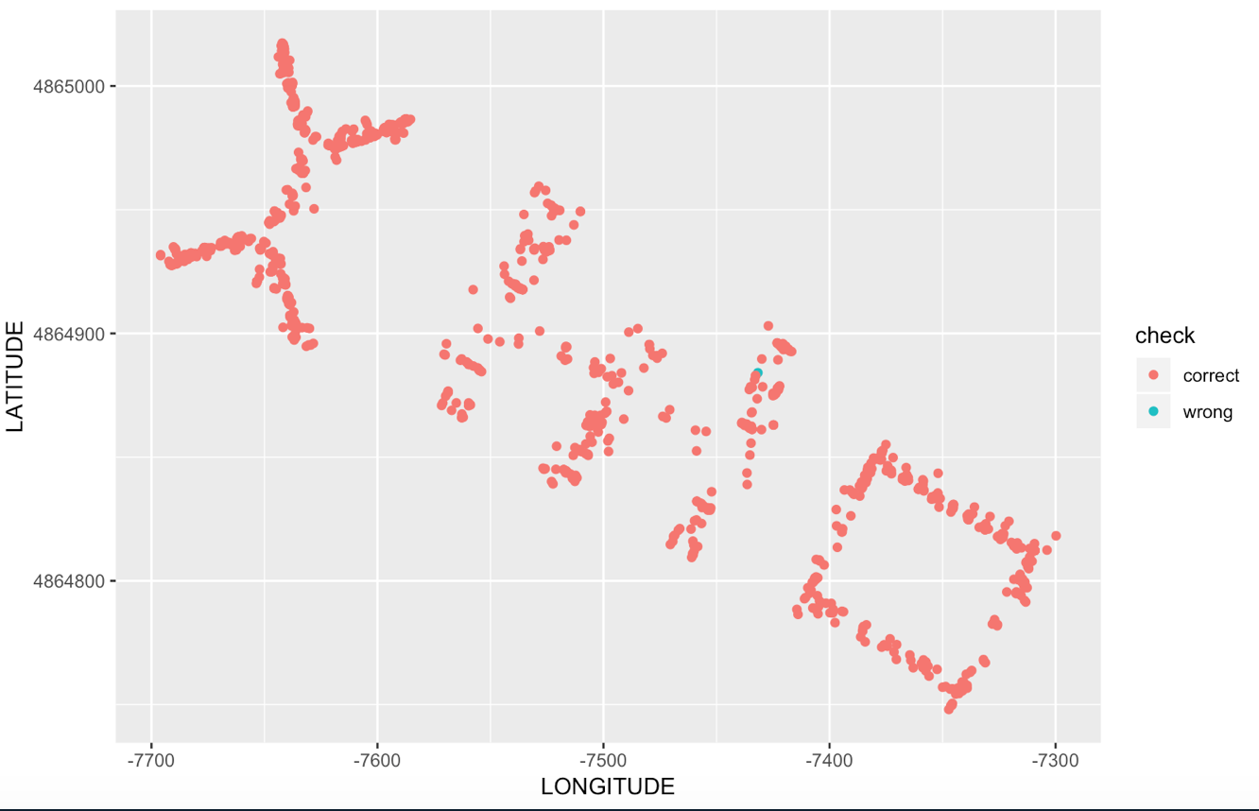
Building prediction
Accuracy Kappa
0.999 0.999

Slide 8
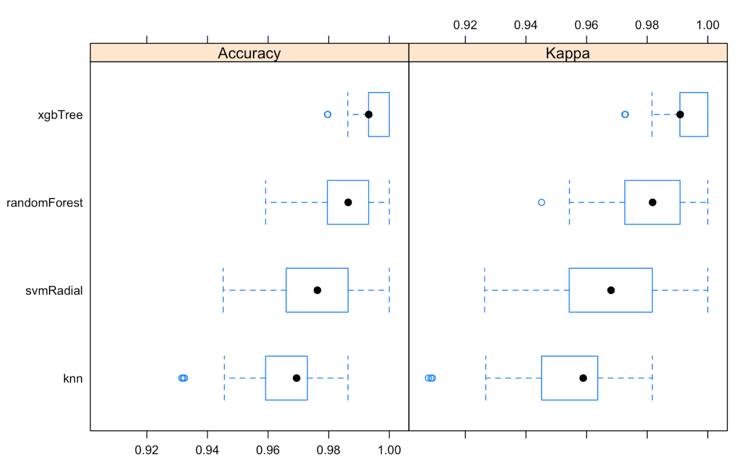
Floor prediction
Building | Accuracy | Kappa
Building 1 | 0.95 | 0.93
Building 2 | 0.81 | 0.72
Building 3 | 0.83 | 0.77
Example: Model comparision for building 2

Slide 9
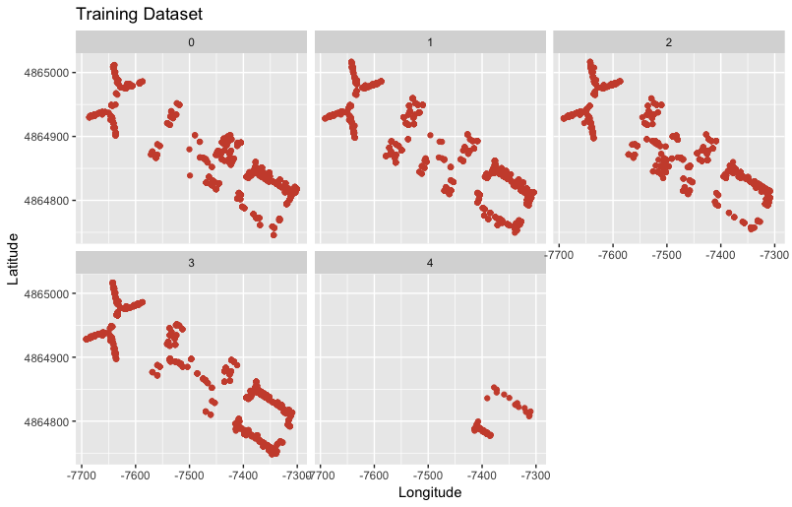
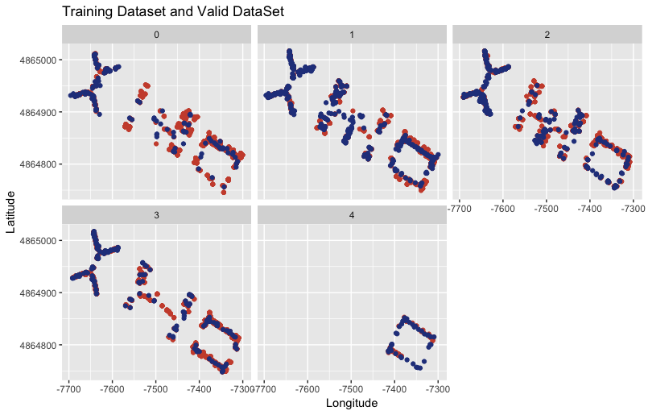
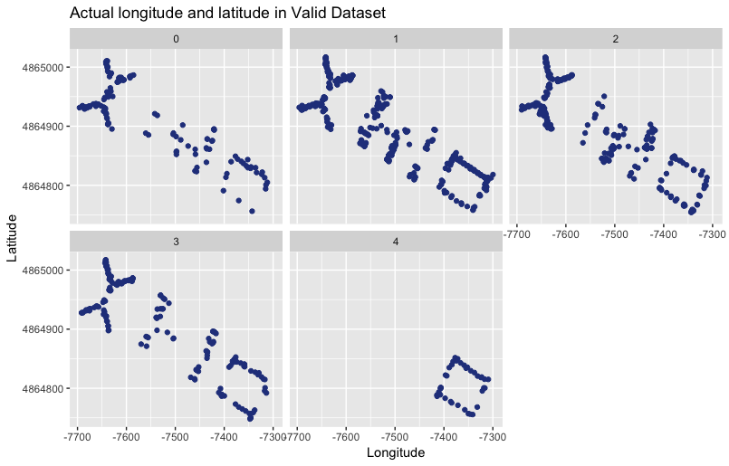
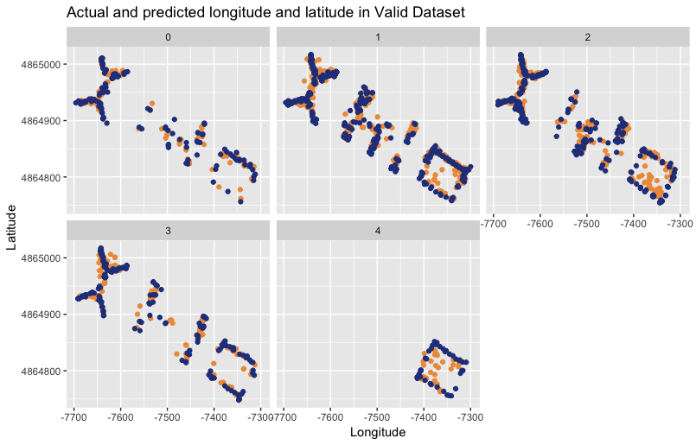
Building | Predicted error distance
Building 1 | 4.1m
Building 2 | 5.6m
Building 3 | 5.2m

Slide 10



Application
Hospital
Shopping mall
Warehouse
...

Slide 11
Challenges and recommendations
Radio map construction
Sample points should cover as much space as possible
Low accuracy in floor prediction
Staggered WAPs position between different floors
Errors in predicted position coordinate
Instead of exact position coordinates,
particular space/room may be more practical
Real time? Delay?
Calculate the latency time

